Slide 1

Animal Services Advisory Board, Director’s Report
FY 25, Quarter 2

Slide 2
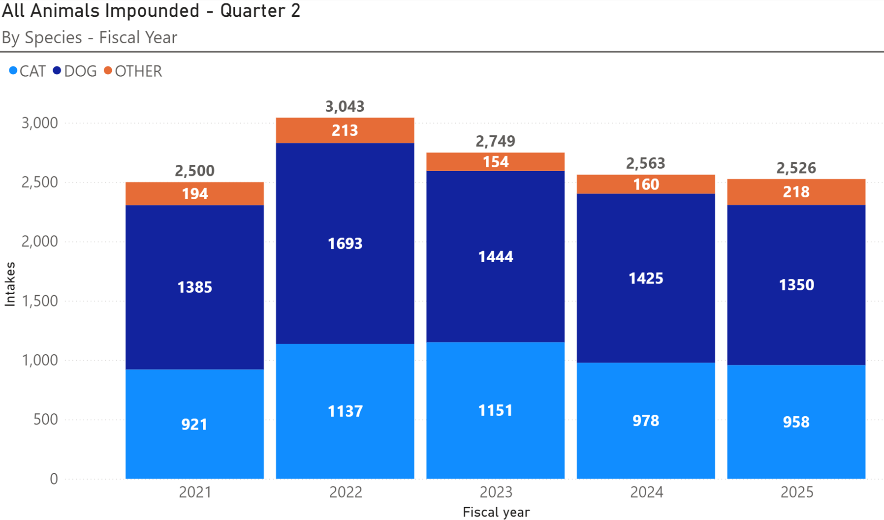
Animal Intake
Notes:
WCRAS received 2,526 dogs and cats and small animals last quarter, totaling 2526 total animals. From the bottom up, 958 cats , 1350 dogs and 218 small animals.

Slide 3
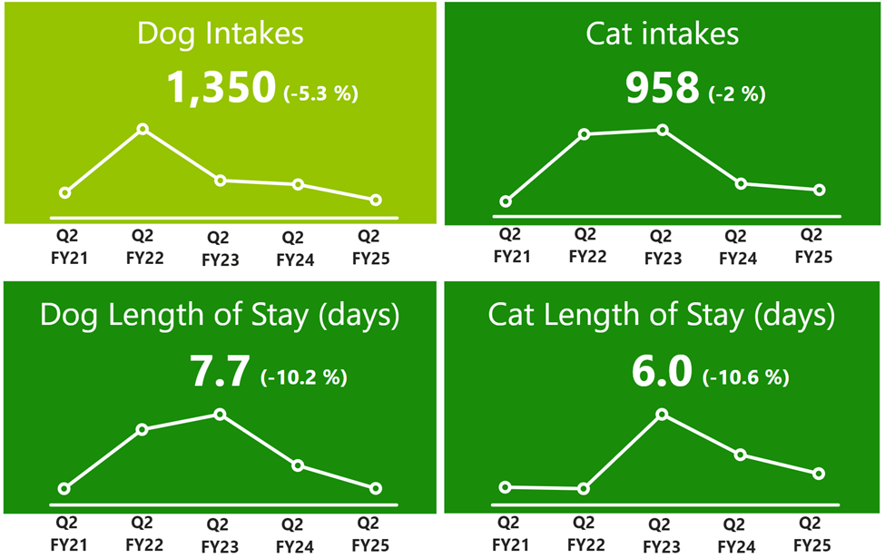
Length of Stay

Slide 4
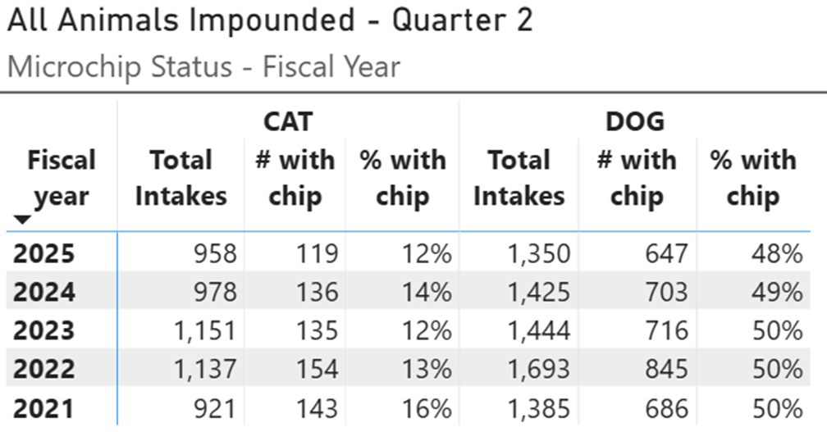
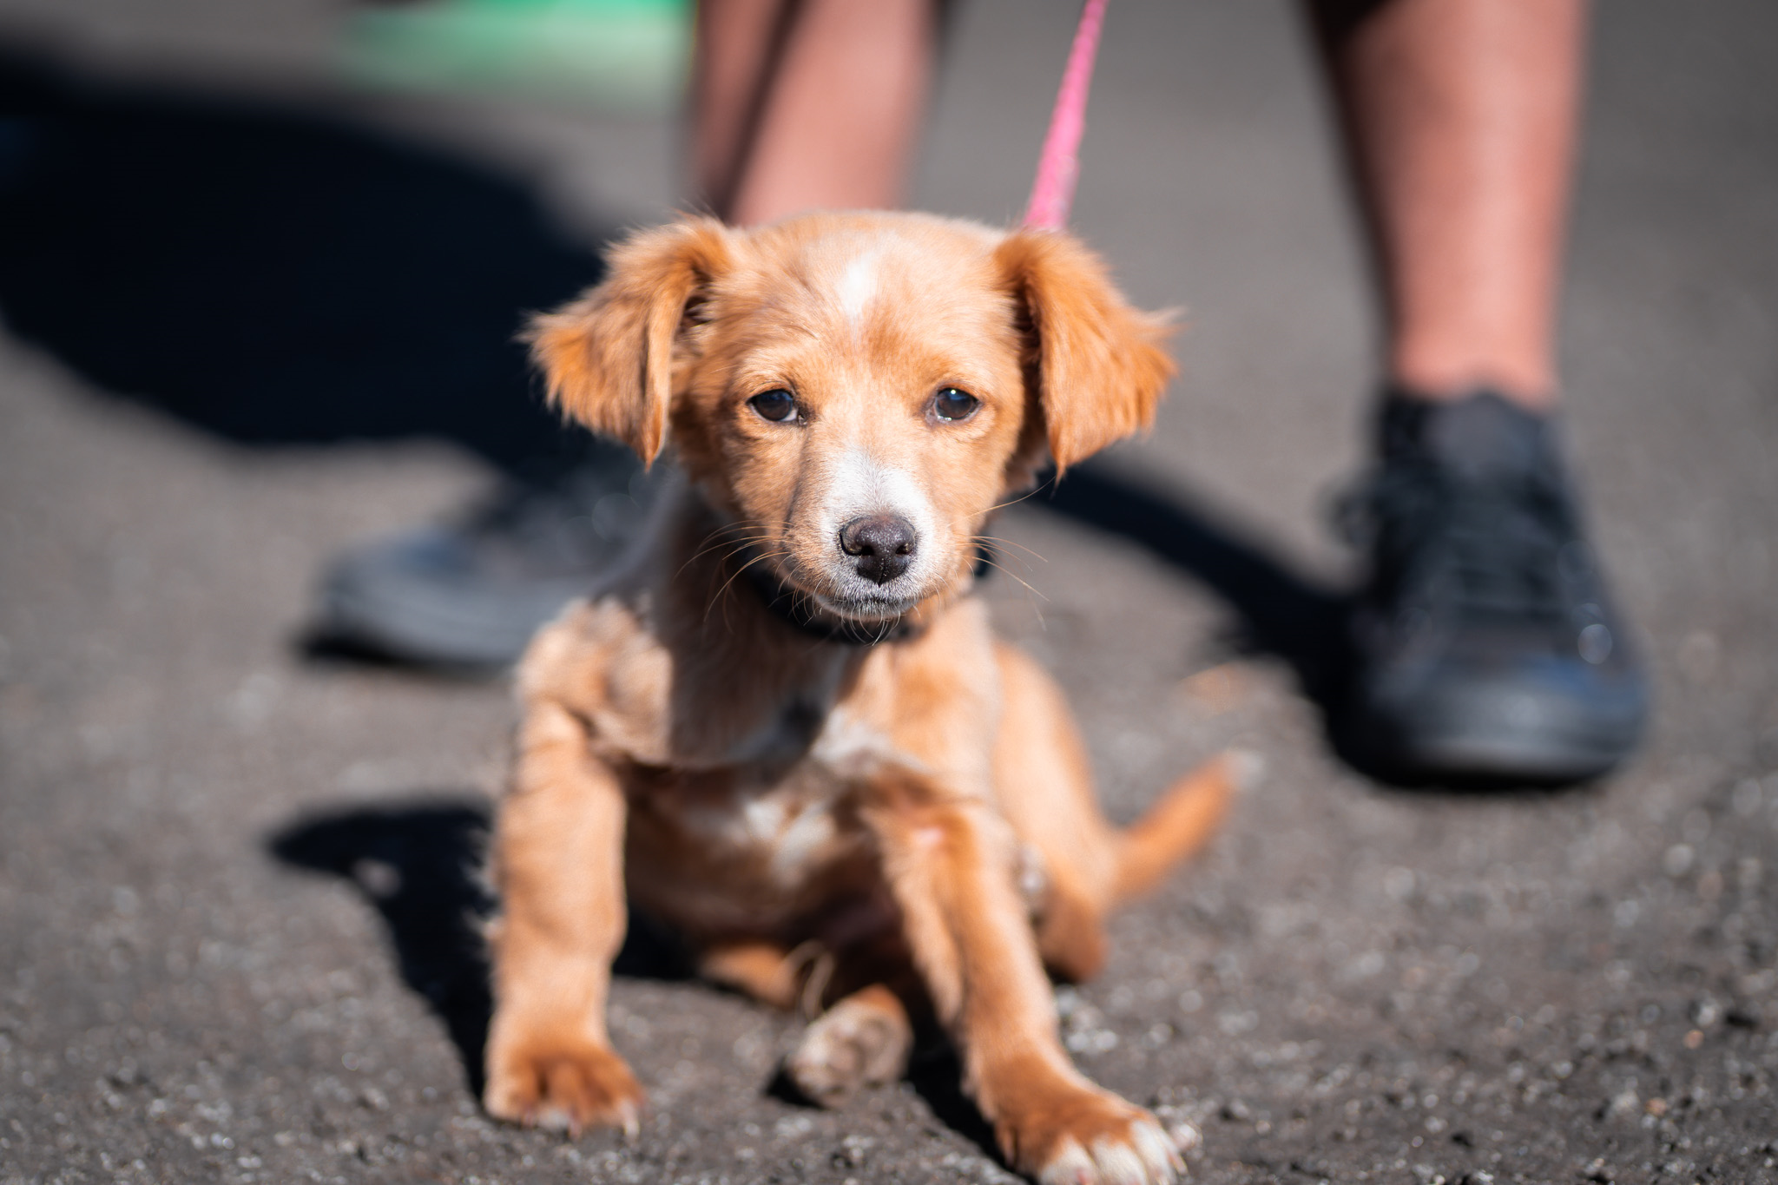
Intake - Microchip stat
Animals Impounded with Microchips

Slide 5
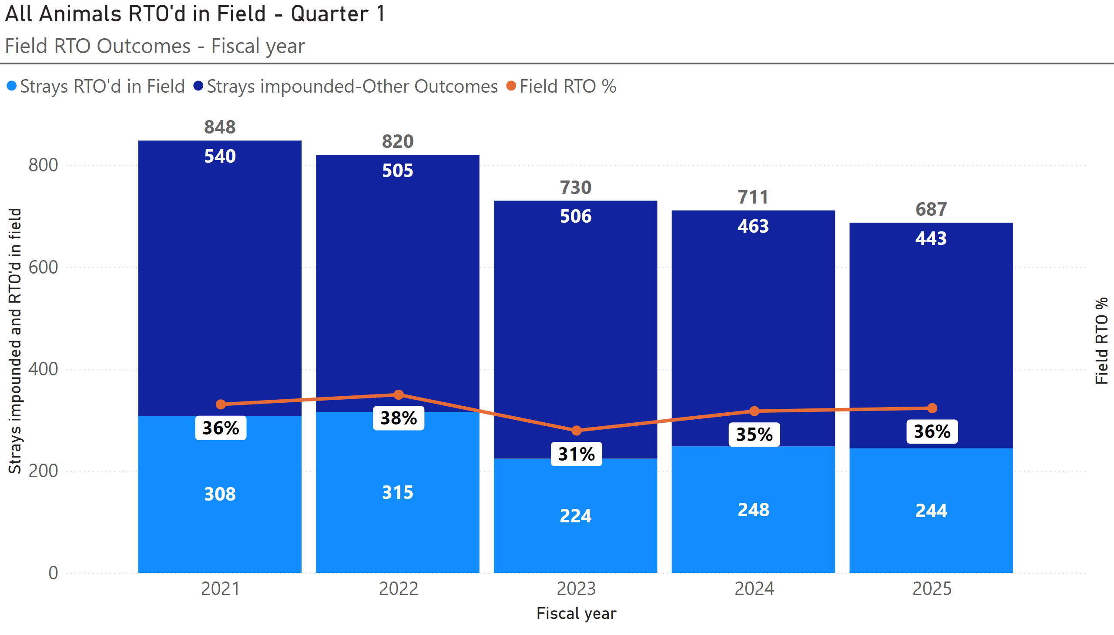
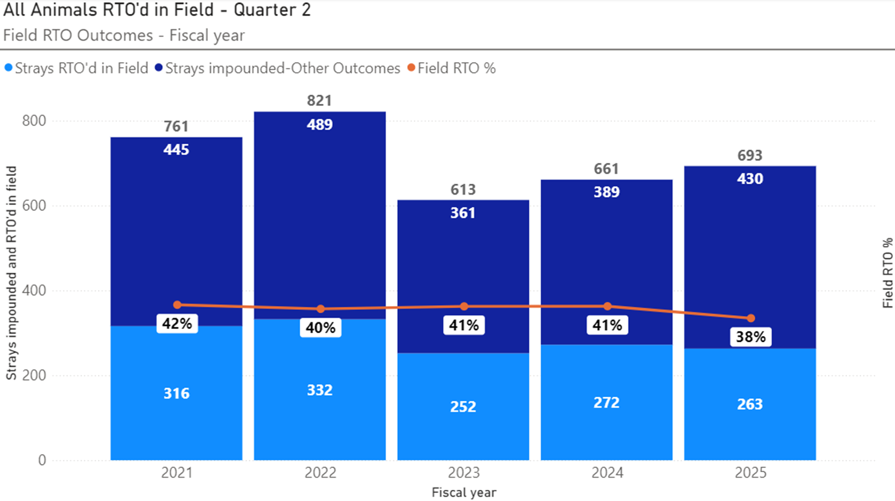
Animals Reunited in Field

Slide 6
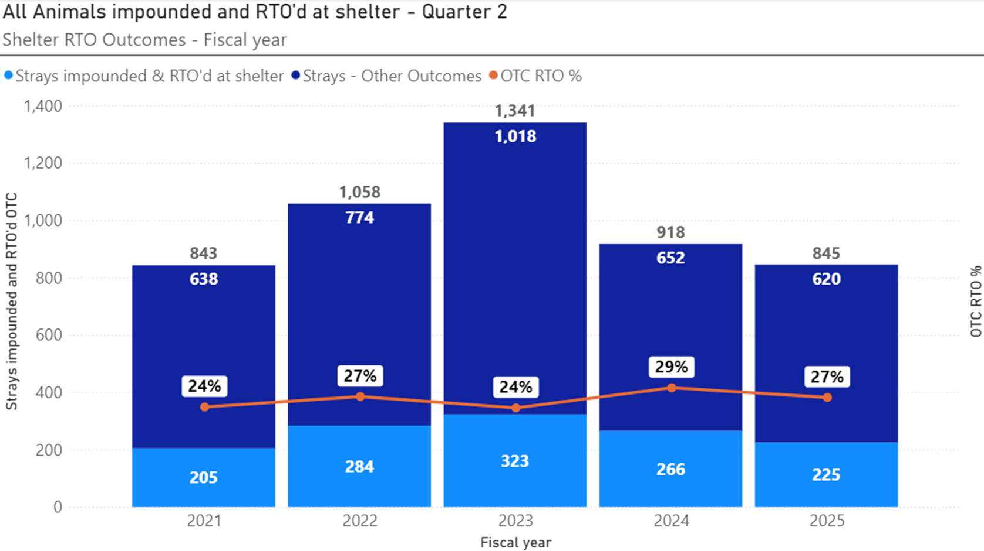
Animals Reunited in Shelter

Slide 7
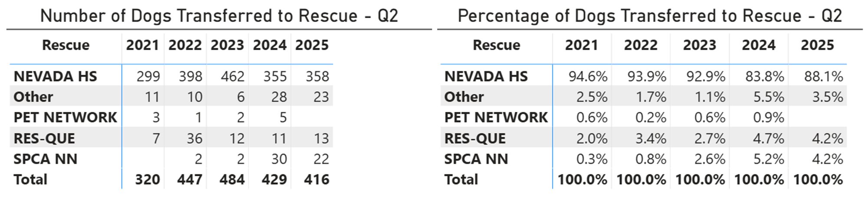
Dog Transfers to Rescue Partners

Slide 8
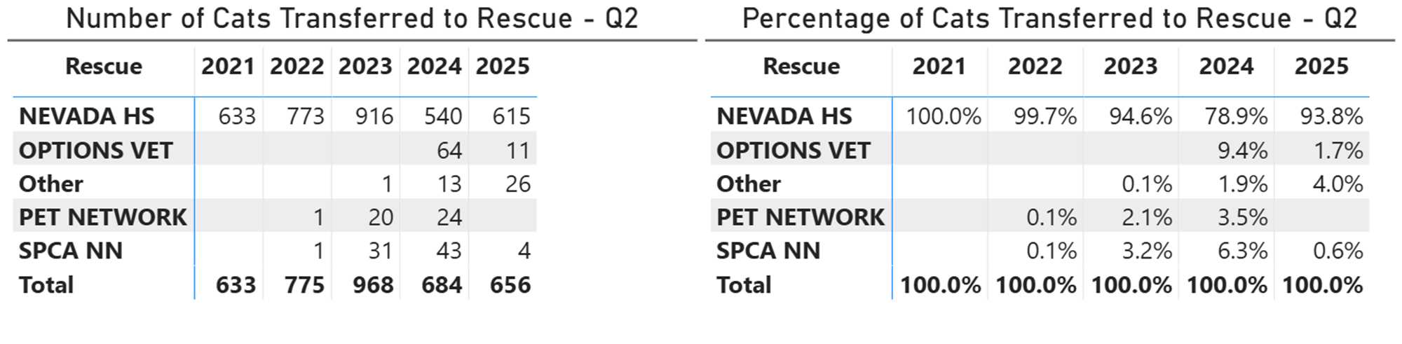
Cat Transfers to Rescue Partners

Slide 9
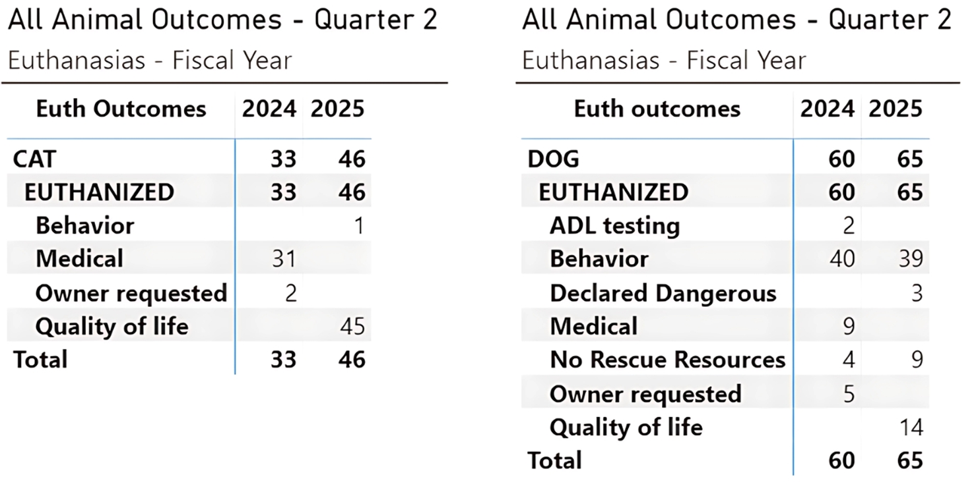
Euthanasia Reasons

Slide 10
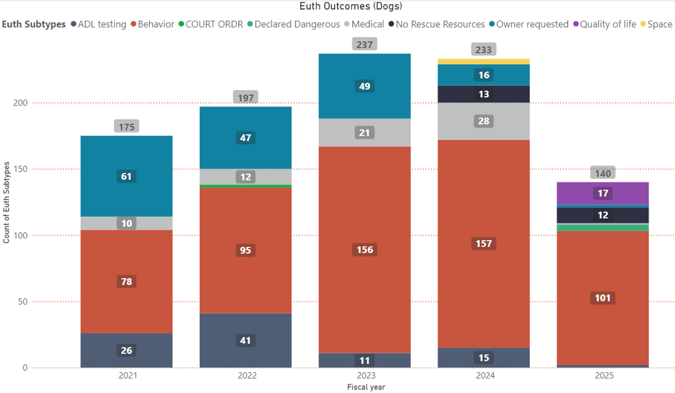
Fiscal Yearly Euthanasia Dogs

Slide 11
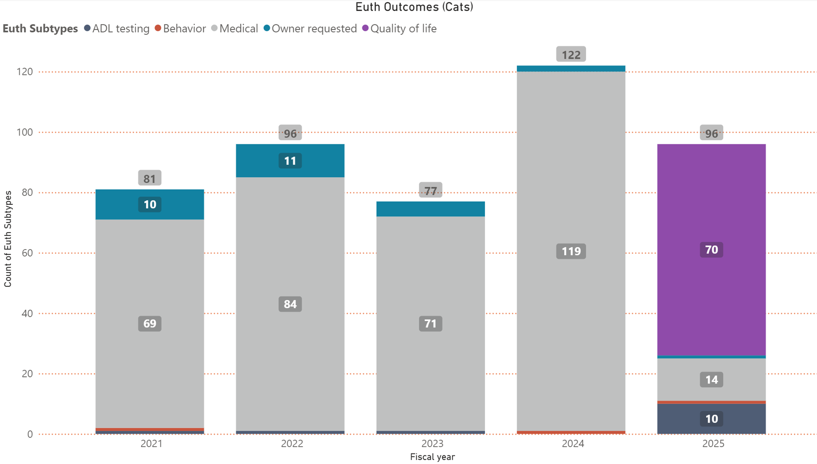
Fiscal Yearly Euthanasia Cats

Slide 12
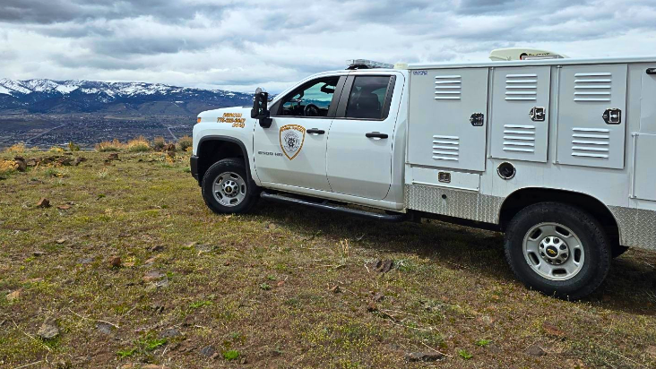
Field Services

Slide 13
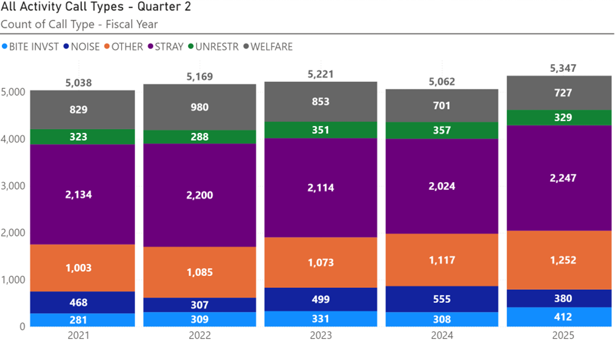
All Field Service Calls

Slide 14
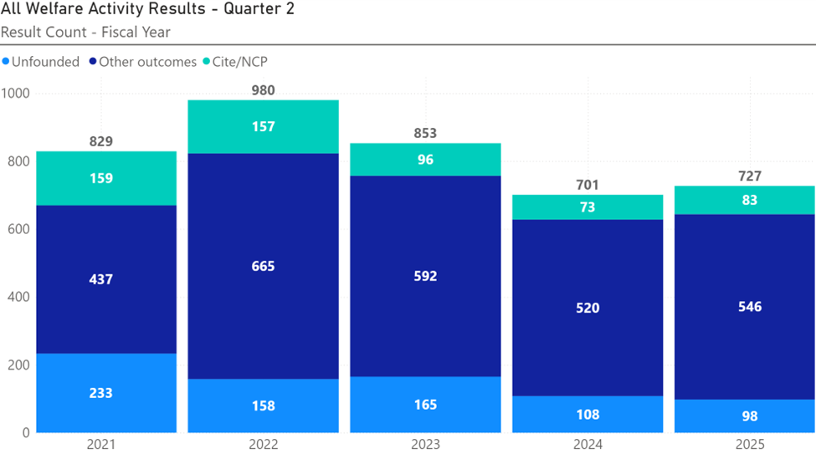
Animal Welfare Calls

Slide 15
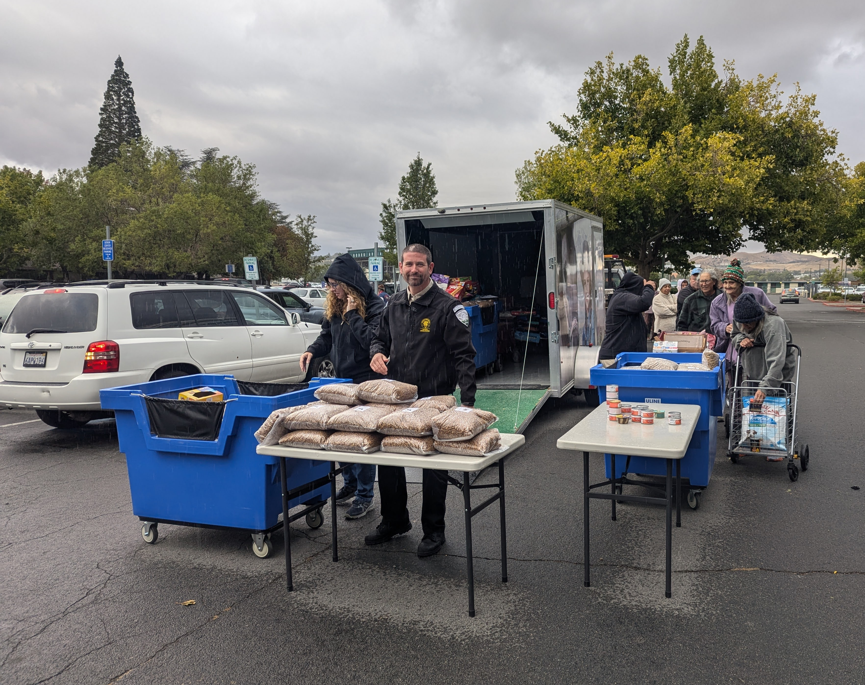
Outreach Programs

Slide 16





Vaccine Clinics & Pet Food Distribution
Q2 FY 24
Q2 FY 25
CARES Support
108
33
Pet food (Seniors served)
217
338
Pet food (Pets served)
451
802
Vaccines Given
740
551
Pets vaccinated
337
338

Slide 17
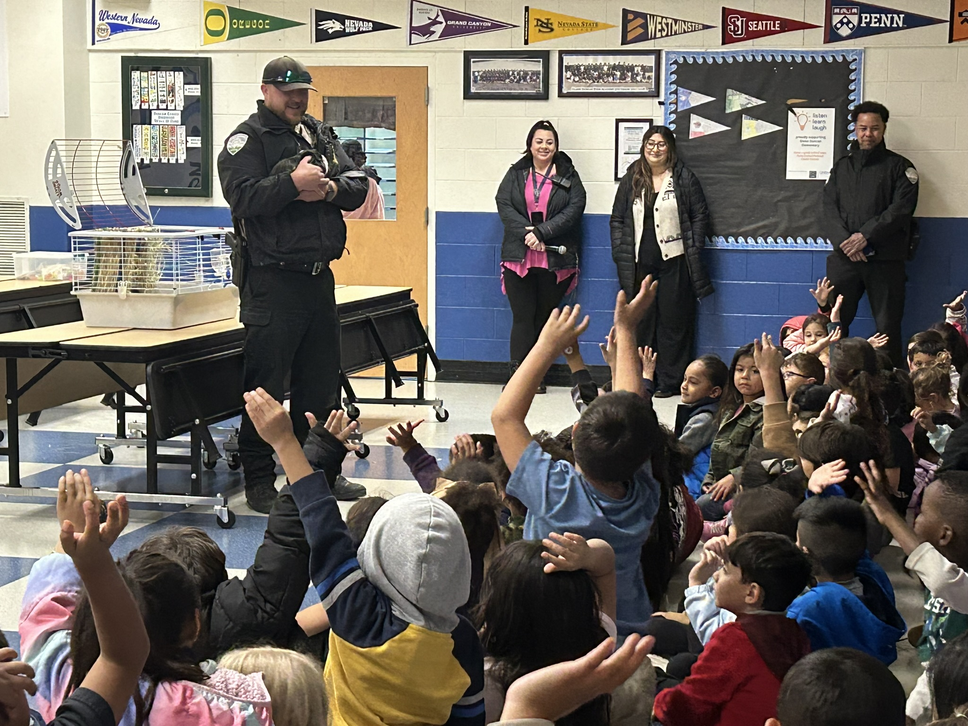
Event Details
  Clinics
3
Vaccination clinics (3)
  338 pets served
  251 rabies vaccines administered
  194 microchips implanted or registered
  Other events
5
Verdi Elementary Pumpkin Patch
Sacramento County Animal Services Shadow of WCRAS
Future Leaders Tour of WCRAS
Glen Duncan Elementary Career Presentation
CERT Disaster Preparedness Presentation
  Pet food Distribution events
3
802 pets of seniors served (480 cats & 322 dogs)

Slide 18
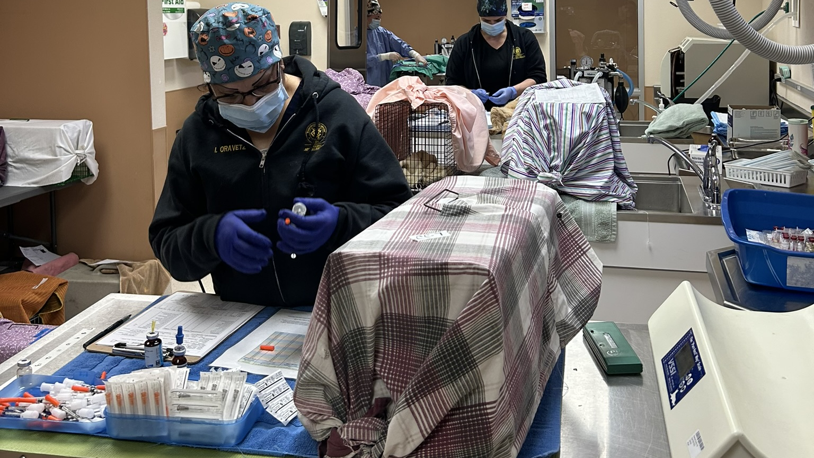
Medical Team

Slide 19
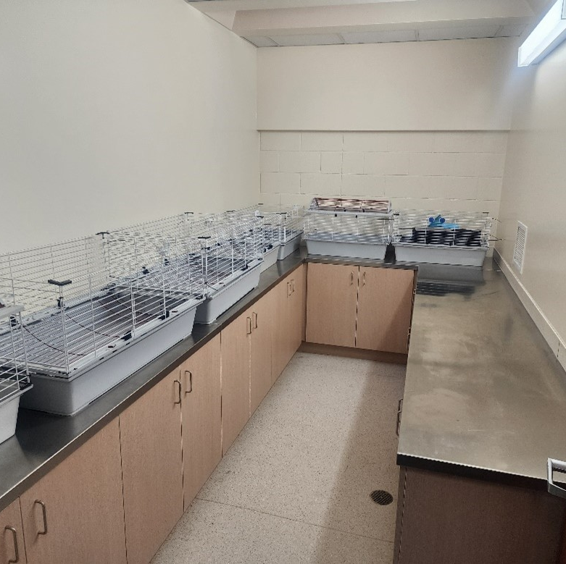
Facility Improvements
Commercial Washer & Dryer
Small Animal Room Cabinets and Stainless Countertops
Interior Door and Kick Plates Refresh
Kennel Flooring Reseal
Play Yard Project

Slide 20
Thank You!

